Slide 1
AdMeta
A privacy-preserving Ad Platform in Metaverse
AdMeta Team

Slide 2
Background

Slide 3
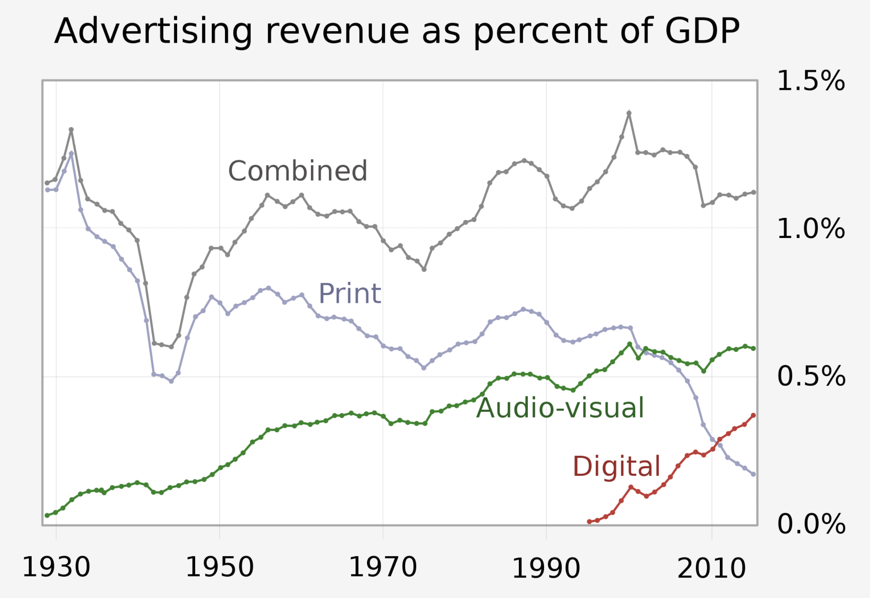
Advertisement Evolution
Online advertising has grown rapidly to become the major part in the advertising industry, since it emerged
Advertising becomes diversified, traceable and precise, with the growing of Web2.
In Web3 and Metaverse, advertising is still in great demand.
Advertising revenue as a percent of US GDP

Slide 4
Demand

Slide 5
Advertising Demand
In Metaverse, a rapidly growing number of projects has created a huge demand for advertising
Projects are looking for an ad platform with precise targeting and tracking
Virtual landholders are willing to monetize ad impressions

Slide 6
Users Demand
Users are willing to try new products that suit their tastes
In the other hand, users are unwilling to expose their privacy to advertisers

Slide 7
AdMeta

Slide 8
What is AdMeta?
AdMeta is a Metaverse ad platform that focuses on privacy preserving
User’s private data is stored on the TEE layer of blockchain
TEE ensures that advertisers can accurately deliver ads to end users without knowing users information
Users are incentivized by completing advertiser’s advertising tasks
Ads are delivered to users according to their wishes and preferences
Spam advertisers cause staking slash, and spam users cause credit decline

Slide 9
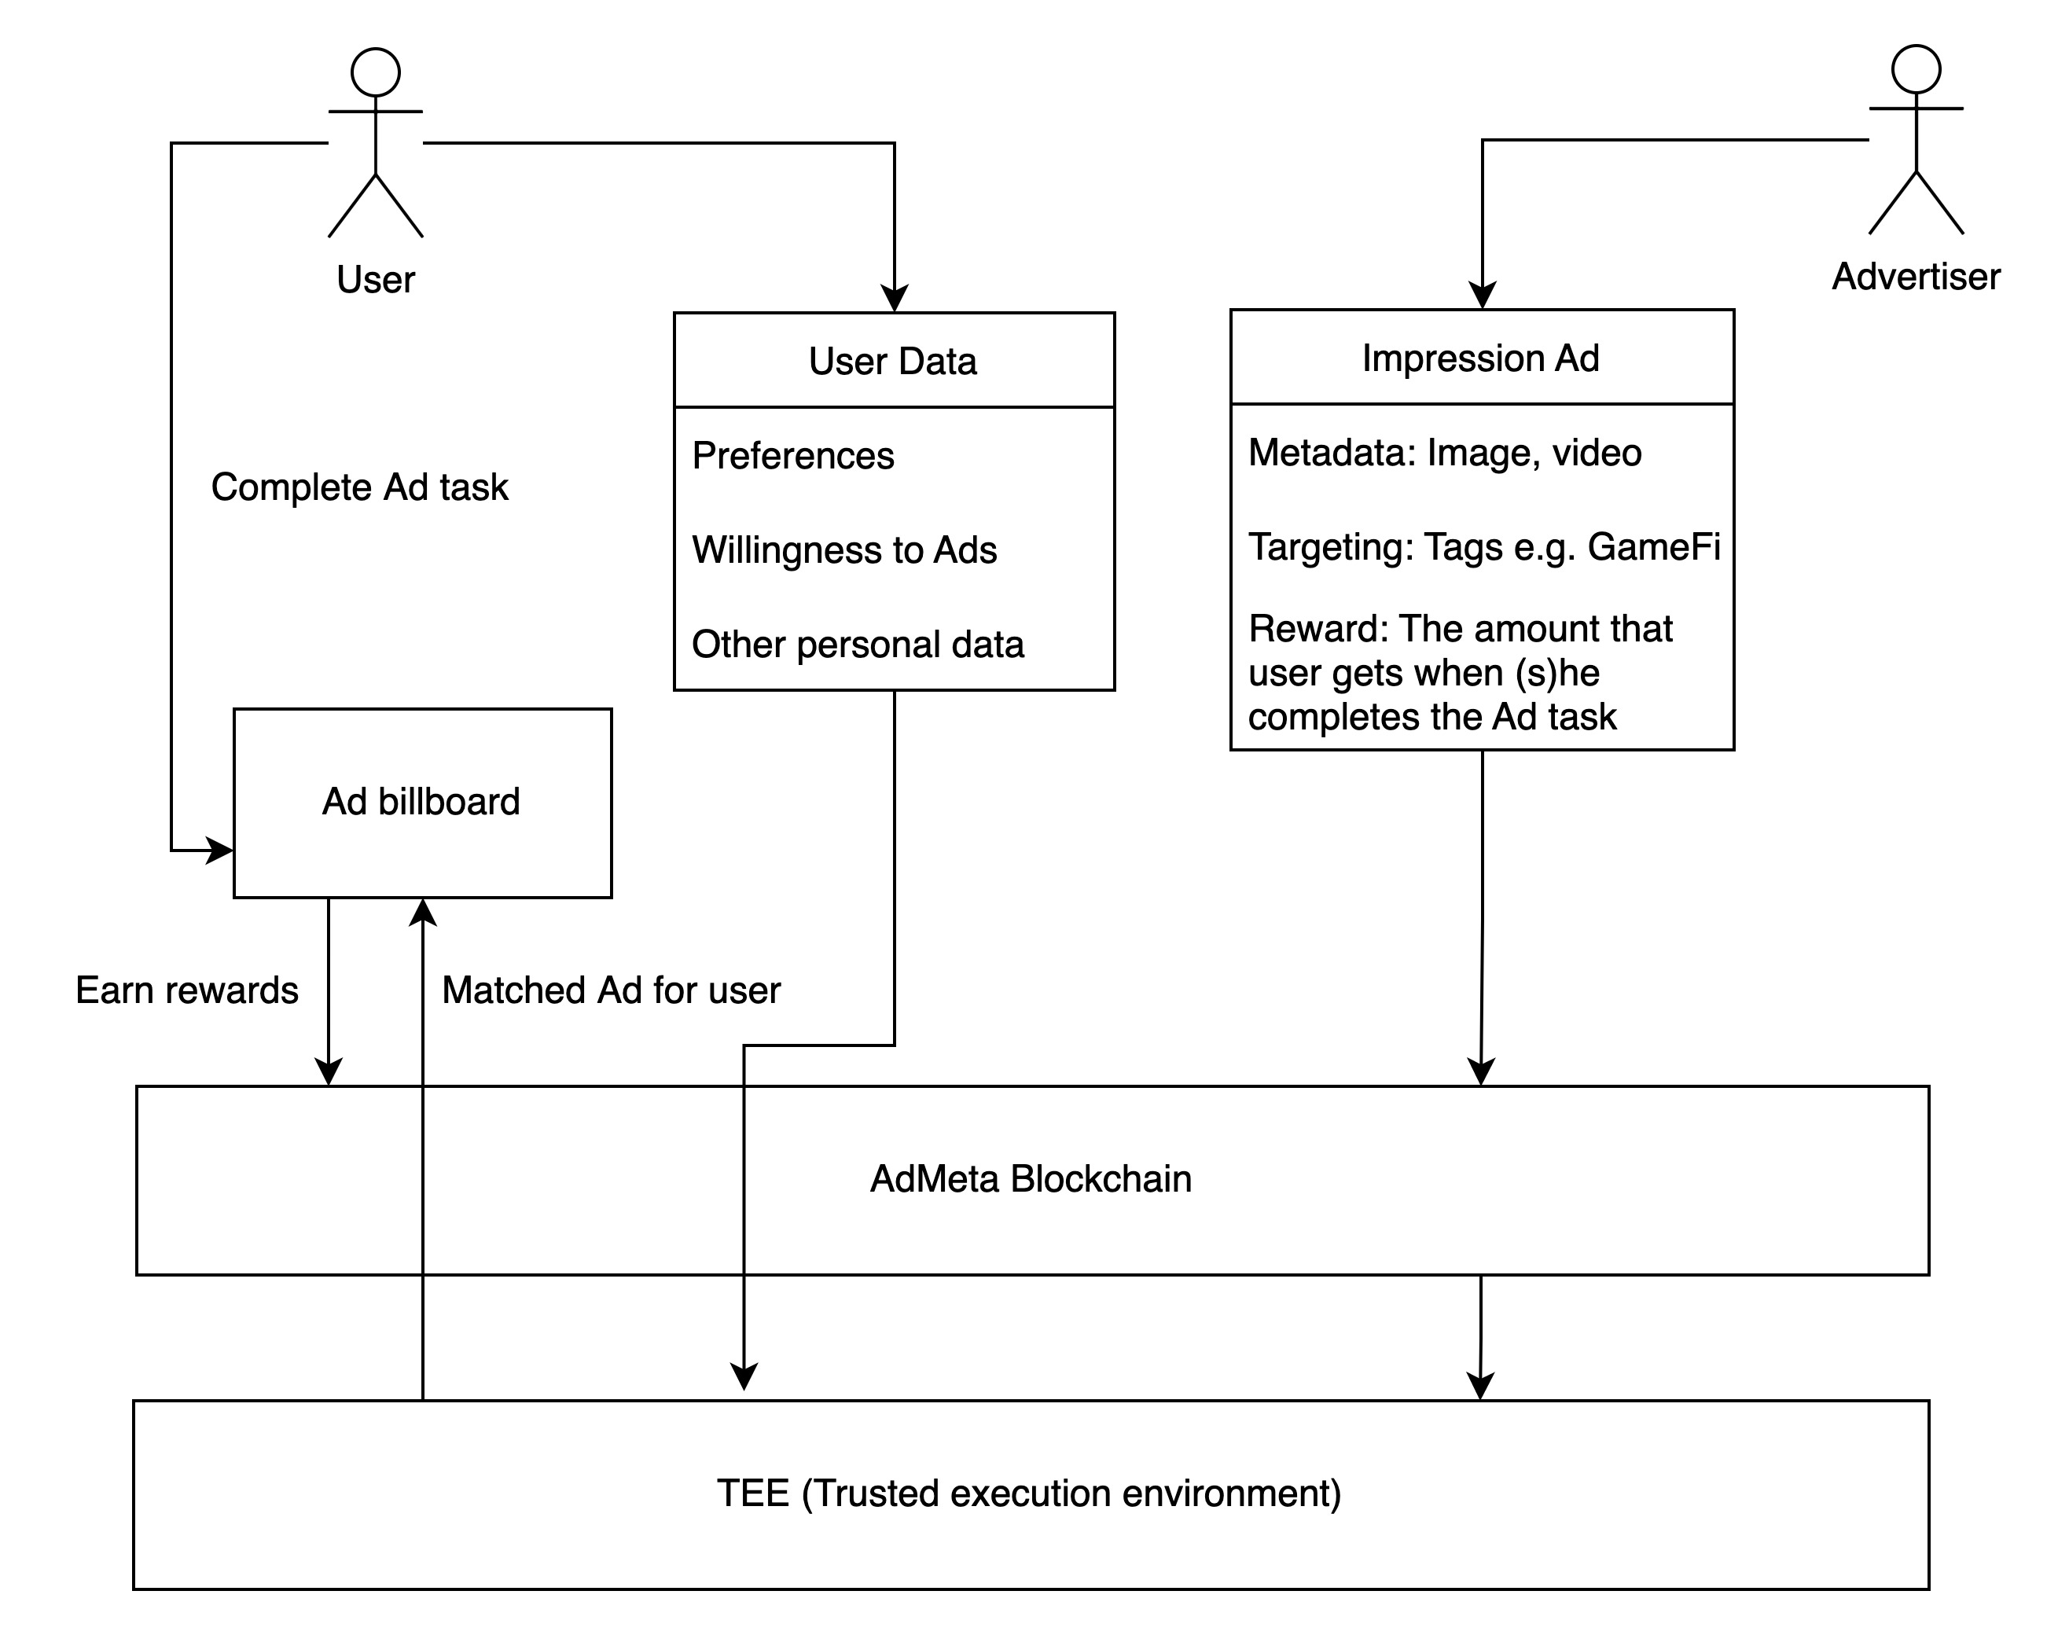
Workflow

Slide 10
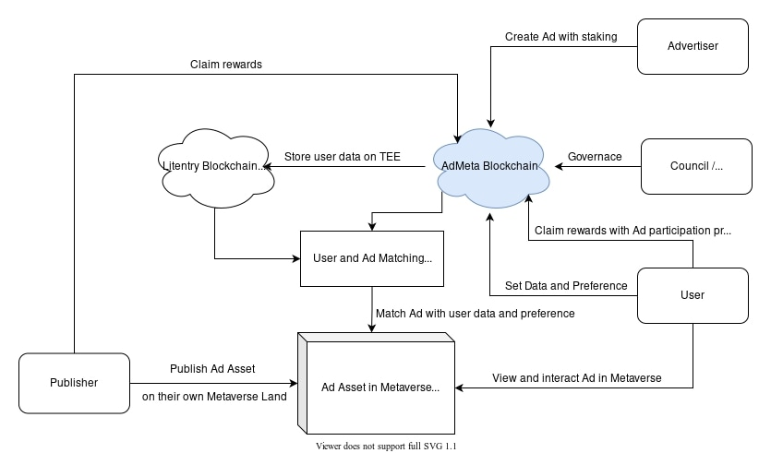
Architecture

Slide 11
Video

Slide 12
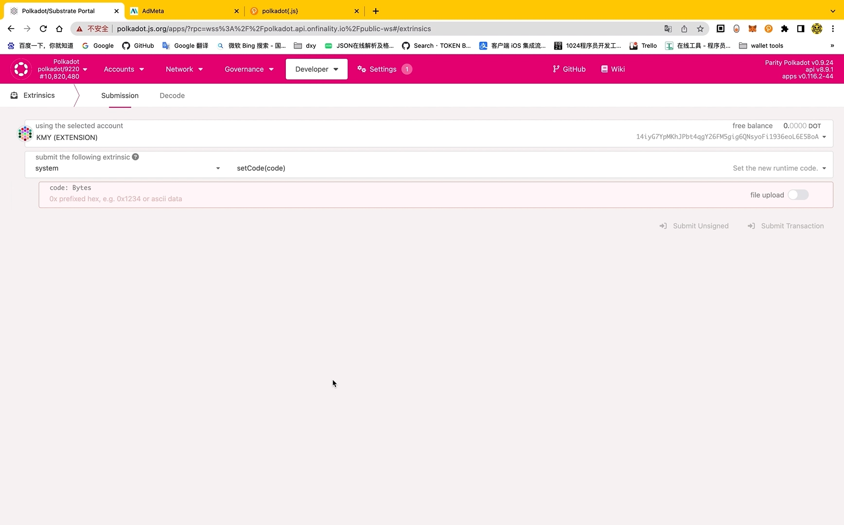

Slide 13
Team

Slide 14
Han - Team Lead & Substrate Dev
Will - Backend Dev
Kmy - Frontend Dev

Slide 15
Contact Us

Slide 16
Website: https://admeta.network/
GitHub: https://github.com/AdMetaNetwork/
Twitter: https://twitter.com/AdMetaNetwork

Slide 17
Thank You

